Slide 1
World Book Kids
Inform • Engage • Inspire
Notes:
These slides were provided by and created by World Book. INFOhio added a few directional slides to help users know how to get to the resources and how to learn more through the Learning Pathways Classes.

Slide 2
Notes:
*This slide has animation. Use Present mode to view.*
To find the World Book Kids resource on the INFOhio website go to the INFOhio homepage: https://www.infohio.org. Click the Ages 3-5 button or Grades K-5 button. The i button will give further training and support for the resource, or click anywhere on the resource box to open the resource.

Slide 3
Site design
Colorful imagery and high interest topics engage reluctant learners
Built-in accommodation tools such as read-aloud, a double click dictionary, and large font
Predictive search to assist with spelling
Multiple ways to find information - explore by picture, direct a search via text, or use various features
An evolving home screen is designed to spark inquiry on new topics
Notes:
For more information/talking points, check here- https://infohio.org/resources/item/world-book-kids

Slide 4
Content
Easy-to-read articles that can be read aloud, translated, saved, and shared
Compare and contrast tools, World of Animals and Compare Places, help kids research their favorite animals and places
Important People, a biography center for young readers
Hands-on science projects and activities
More than 50 educational games across five subject areas
Geography tools: an atlas, interactive maps, and outline maps and flags
Age-appropriate WebQuests provide exploratory print-and-do activities
Notes:
For more information/talking points, check here- https://infohio.org/resources/item/world-book-kids

Slide 5
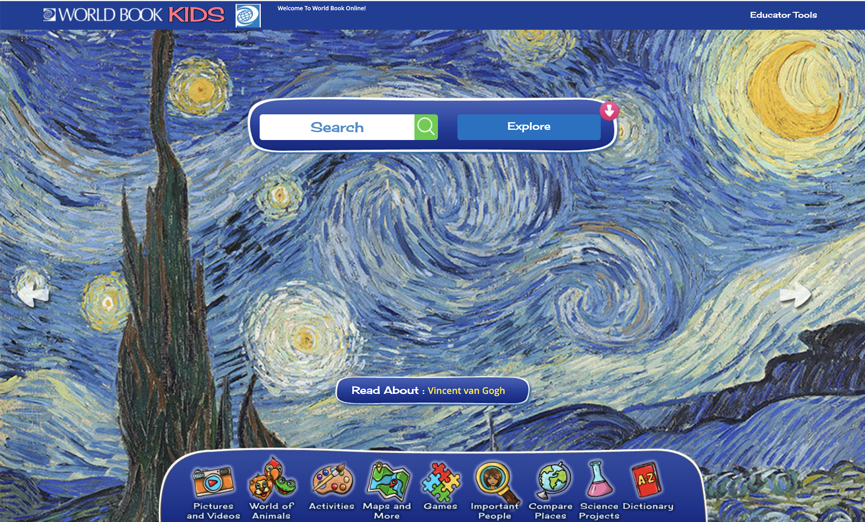
Features

Slide 6
Kid-friendly search for independent navigation
Predictive search helps emergent spellers find content and sparks inquiry.
The explore feature allows a virtual dig using pictures to find content.
Search results are presented with a variety of formats to meet various learning styles: read an article, look at pictures, watch a video, or explore maps!

Slide 7
Hone compare- and-contrast skills
World of Animals & Compare Places allow students to learn about animals and places using the interactive compare-and- contrast features. Simply pick two and compare now!
View information in Quick Fact format, navigate to an article, and more!
STEM
Geography

Slide 8
Disguise learning with games
Over 50 educational games
Puzzles, matching, sorting, crosswords, and more
Organized by type or subject
Perfect for fun at-home extensions of lessons
A variety of subjects for cross-curricular support
Incorporate into lessons for assessment or to reinforce subject matter understanding

Slide 9
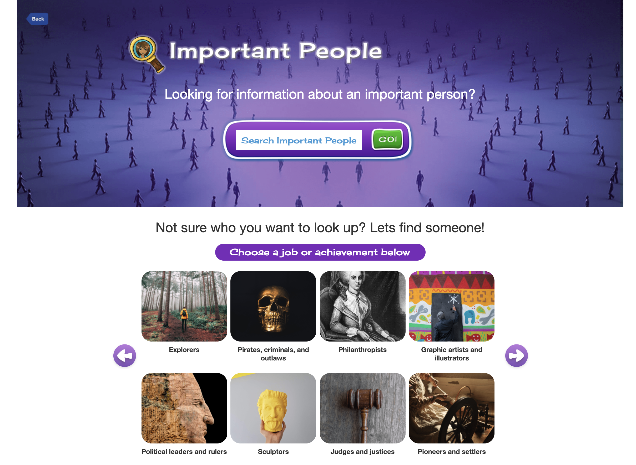
Important People
Biography center with hundreds of biographies written for the elementary reader
Search or browse by job/achievement
Add filters such as male/female, country of origin, and time period

Slide 10
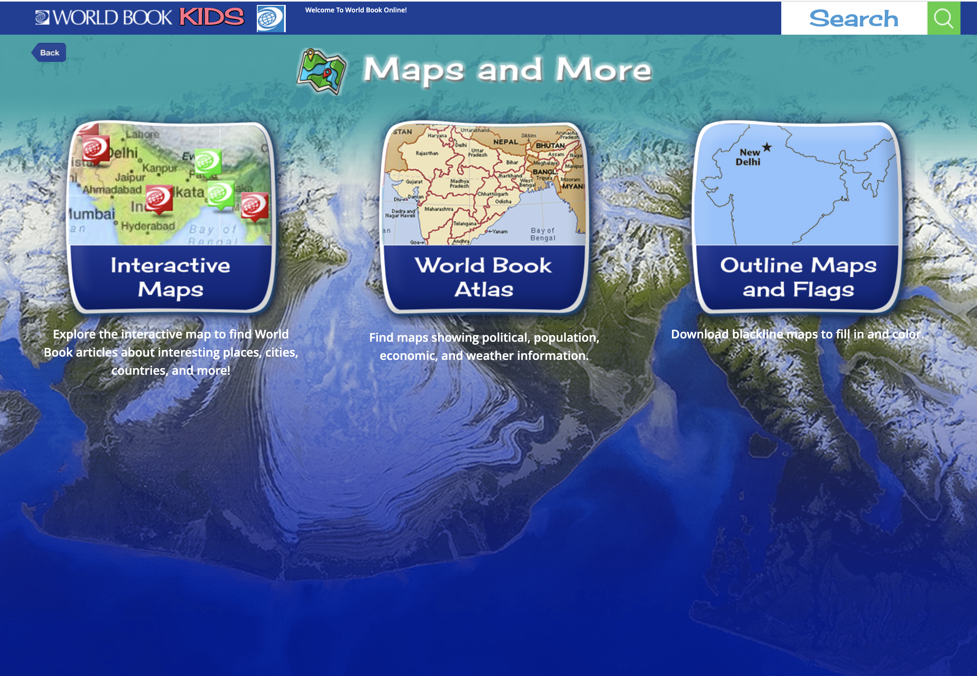
Maps and More
Interactive Maps-- explore the world map and find important places and their encyclopedia article linked.
World Book Atlas-- maps showing political, population, economic, and weather information.
Outline Maps and Flags-- blackline maps to fill in and color.

Slide 11
Activities & Science Projects
Incorporate art with a fun activity! Choose from 11 fun categories like doodle and design, treasure hunt, creature feature, and more.
Find a science project in one of these 8 categories. Each project comes with a list of easy-to-find materials, links to World Book Kids articles to build background knowledge, and discussion questions.
Whether these are teacher-led or completed at home, the How to Do a Science Project guides students through the scientific process.

Slide 12
Tools to elevate learning

Slide 13
Articles include features to guide learners
Built-in read-aloud function includes a word-by-word highlight while reading to help with pronunciation and understanding new words in context.
Double click any word for a pop-out dictionary definition.
Pictures and videos tabs allow kids to look at related media
The More Information tab holds links to related articles, activities, games, lesson plans and more. Use the questions for assessment pre-reading, during reading, or post reading for comprehension checks.

Slide 14
Extend learning
After students have read an article, they are offered more information at a higher reading level or in Spanish. At the bottom of every article in Kids students can click to the same topic in Student, Hallazgos, or Découverte!
In addition to the article, students are offered other content, such as images, multimedia, WebQuests, and activities for project-based learning.

Slide 15
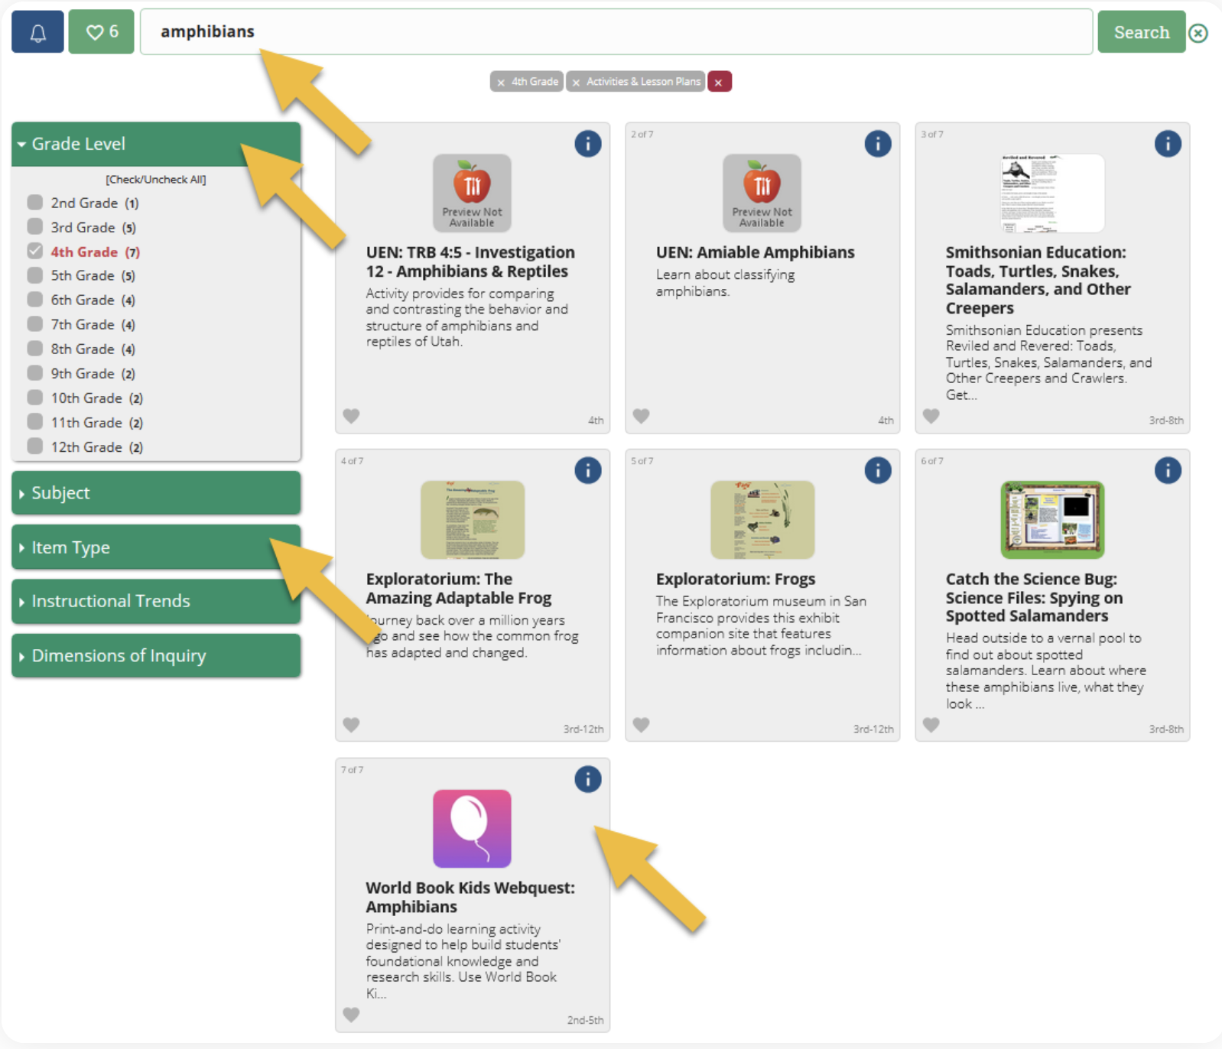
WebQuests
Organized by subject, WebQuests are great for building background knowledge before a unit, as a tool for further information and research, or as an assignment within the unit!
A variety of question types help build students’ comprehension skills and ability to look for information in multiple formats.
Have confidence that students will be successful in their quest because each one is designed to be conducted within the given World Book product.
The teacher page includes an answer key.
Use the Research Skills WebQuests to introduce students to Kids at the start of the year. This quest will lead them through the resource so they are comfortable navigating around and using this on their own!
Find WebQuests by searching in INFOhio’s Educator Tools.
Notes:
Searching for “webquest” or a specific webquest is easy when using INFOhio’s Educator Tools.

Slide 16
Educator Tools
Search for material by standard
Save time and look for content by learning objective. Use the curriculum correlations feature under Educator Tools.
Lexile Level
Pull content from Kids to work into platforms you already utilize.
Any article can be shared directly with Google Classroom by going to the gear wheel and click Share to Google Classroom.
Looking for material by Lexile level? Check out Advanced Search.
Lesson Plans
Access over 75 lesson plans that accompany activities, science projects, and games. These include in-depth procedures with additional guidance for educators, discussion questions, and assessment tools.
Notes:
World Book also includes Educator Tools.

Slide 17
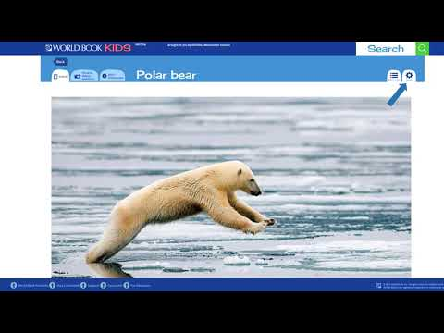
Direct Access to Articles from INFOhio’s ISearch
Notes:
Watch this video to learn how to share articles from World Book Kids using INFOhio’s ISearch.
INFOhio’s ISearch: https://isearch.infohio.org, lets you search nearly all INFOhio resources from a single search box.
If you use a platform, other than Google Classroom, articles from World Book Kids can also be shared with a direct permalink from ISearch that will work in any learning management system.

Slide 18
Tools to expand your reach
The Tools section of any article, activity, science project, and more offer multiple ways to share content.
Print to provide resources for students without internet access at home. Include multiple sources in a take-home packet to work offline.
Save content to OneDrive or Google Drive for easy collaboration with colleagues.
Translate articles into over 100+ languages
Adjust settings for additional accommodation such as read aloud speed.

Slide 19
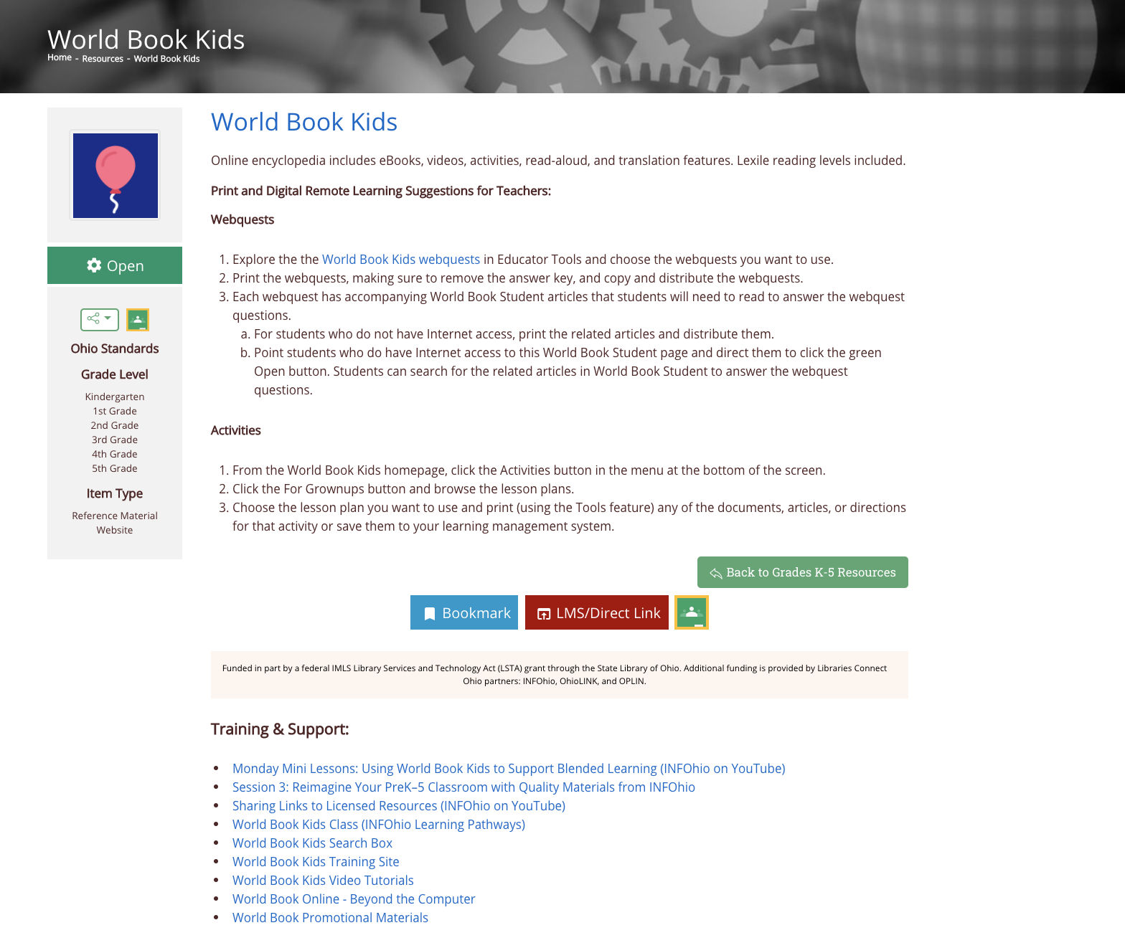
Ideas & Training
Notes:
https://infohio.org/resources/item/world-book-kids

Slide 20
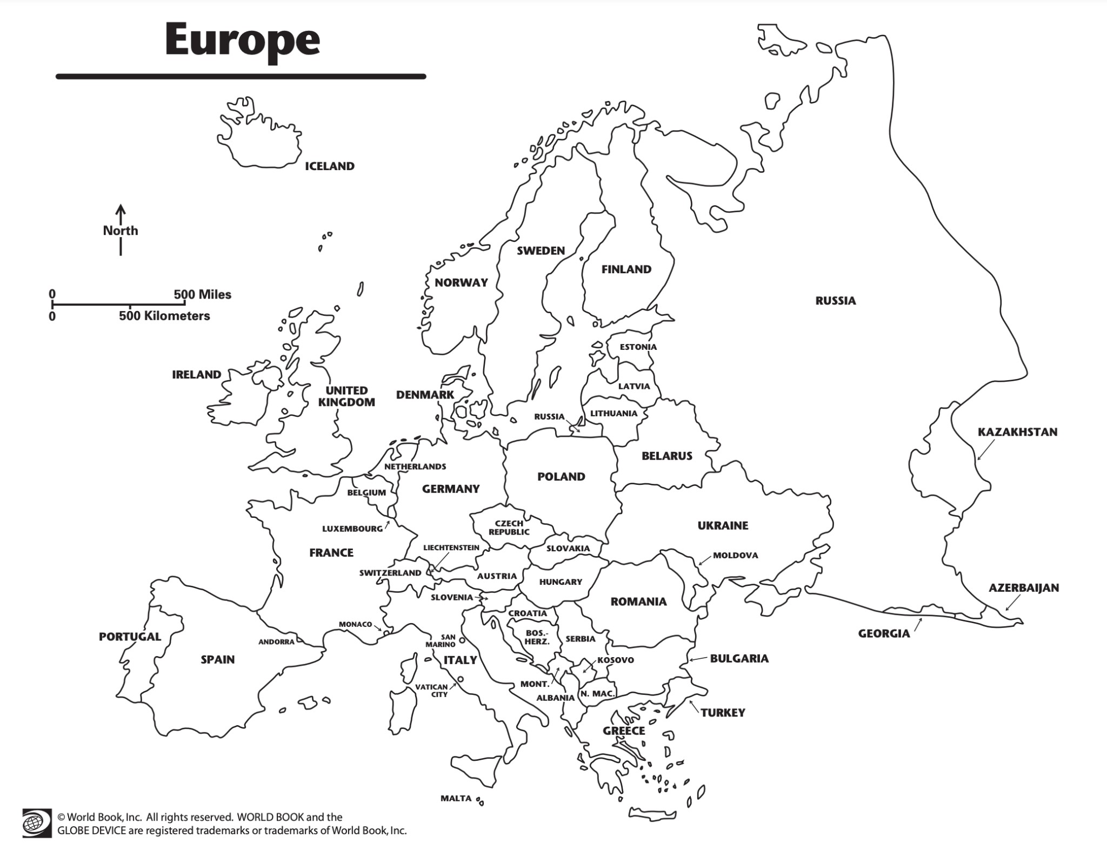
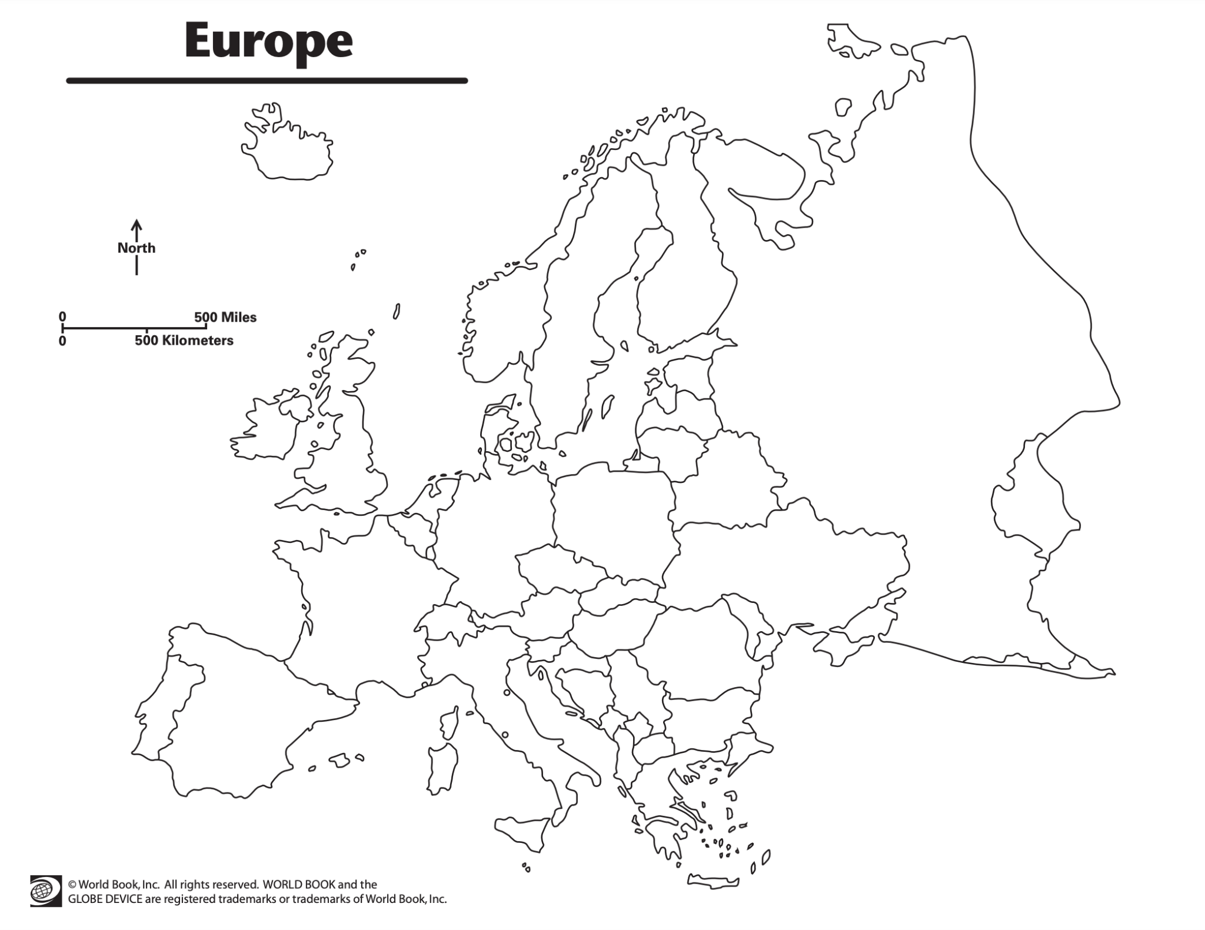
Ideas for Use in the Classroom
Build comfort researching online with Explore and Search options
Build background knowledge or guide research with pre-created WebQuests
Develop compare and contrast skills with World of Animals & Compare Places
Use Important People for reports and projects
Play educational games
Get hands-on with activities & science projects
Have students self-check answers with outline maps & flags
Notes:
For more information/talking points, check here- https://www.worldbookonline.com/training/products/kids/kids-index.htm

Slide 21
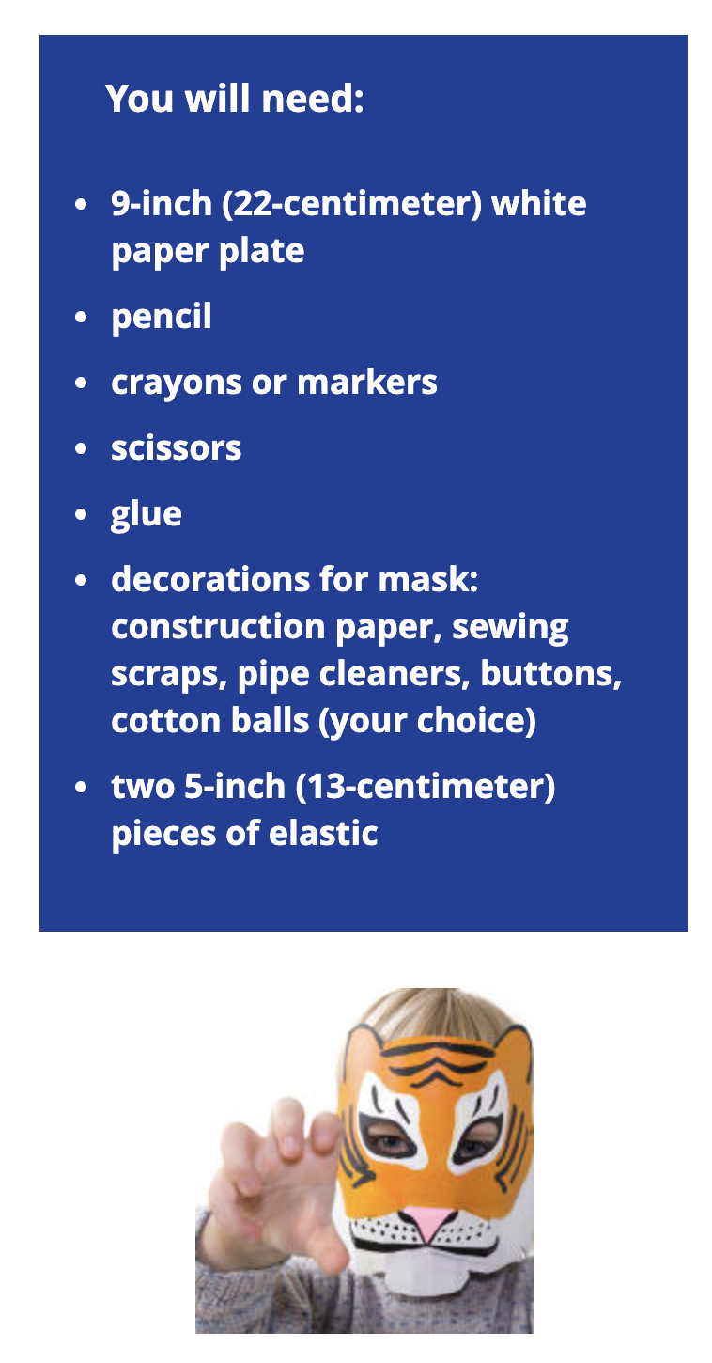
Ideas for Use in the Library
Ignite curiosity with pictures and videos
Tie Kids into summer reading programs
Have kids play educational games while parents research
Look up characters, authors, and other items from books you read together
Print off activities for stations around the library
Direct home school instructors to the Educator Tools section for lesson plans, WebQuests, and more!
Notes:
For more information/talking points, check here- https://www.worldbookonline.com/training/products/kids/kids-index.htm

Slide 22
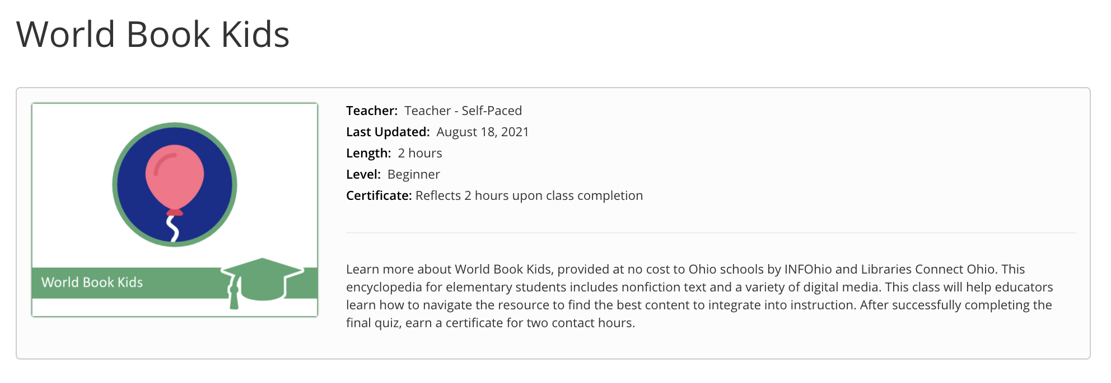
Learn More with INFOhio Classes
INFOhio Campus provides classes to help teachers integrate licensed resources into their classrooms.
Take this asynchronous, self-paced, World Book Kids Class and earn 2 contact hours after completion of the final quiz.
Notes:
https://infohio.org/campus/learning-pathways/course/world-book-kids

Slide 23
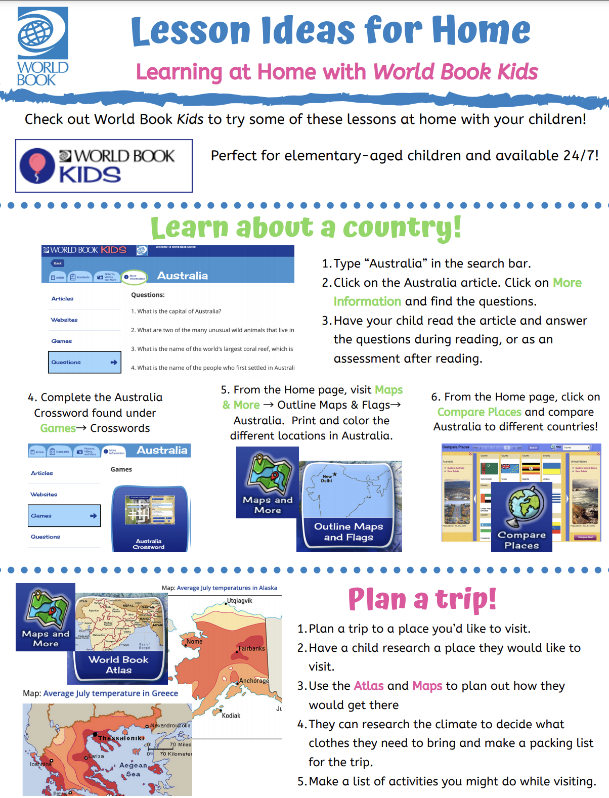
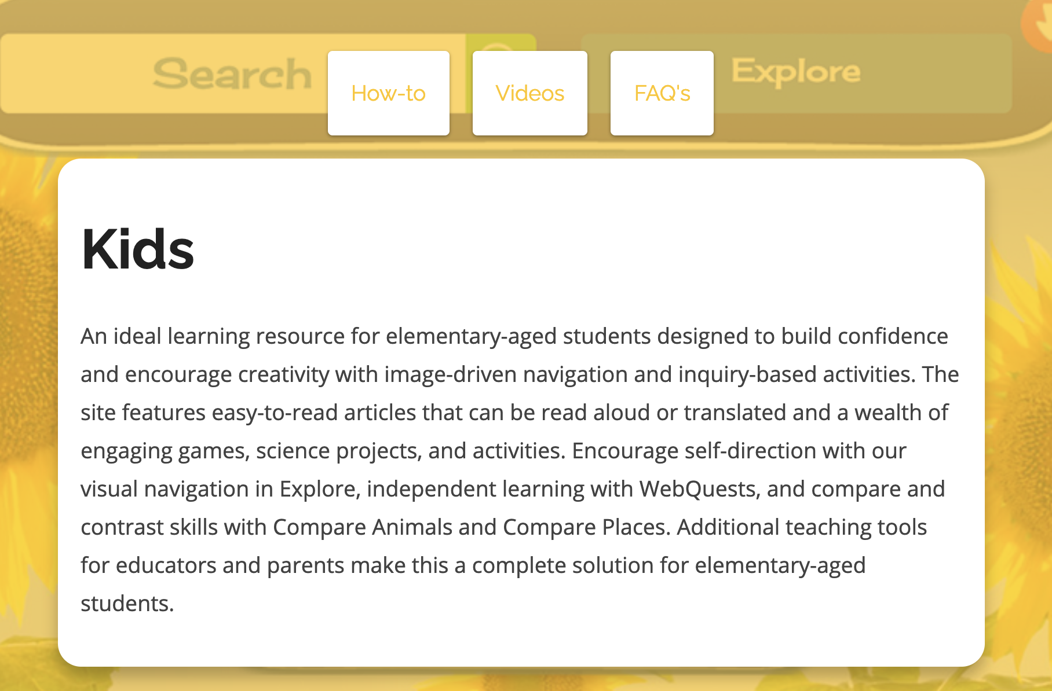
Training Material
Free promotional material such as colorful social media posts, bookmarks, flyers, and more!
How-to articles and tutorial videos on each feature of Kids
Ideas for use in the classroom & at home
Resources for students
Notes:
For more information/talking points, in addition to the information page from the INFOhio site at https://infohio.org/resources/item/world-book-kids , check here- https://www.worldbookonline.com/training/products/kids/kids-index.htm

Slide 24
Presented by:
Contact Me!

